Slide 1
Introduction to Cells

Slide 2
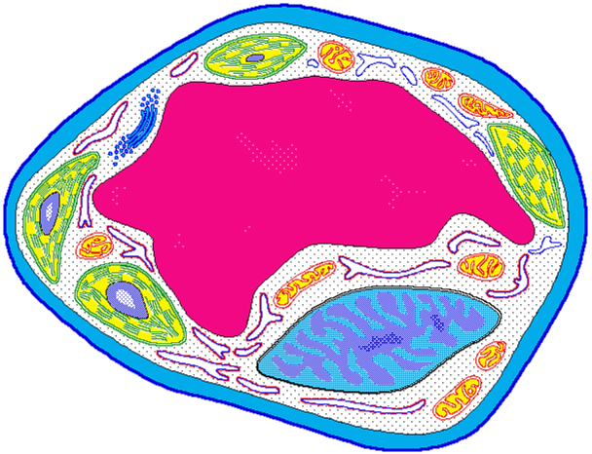
What is a cell?
A cell is the smallest unit that is capable of performing life functions.

Slide 3
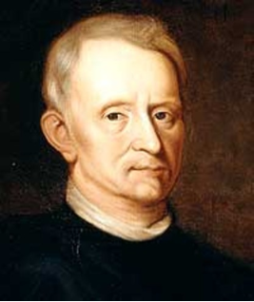
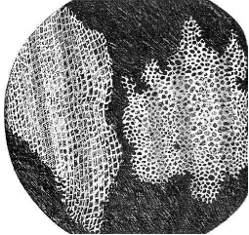
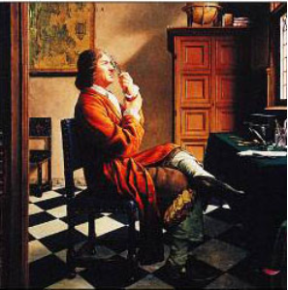
Early Contributions
Robert Hooke - First person to see cells, he was looking at cork and noted that he saw "a great many boxes. (1665)
Anton van Leeuwenhoek - Observed living cells in pond water, which he called "animalcules" (1673)

Slide 4
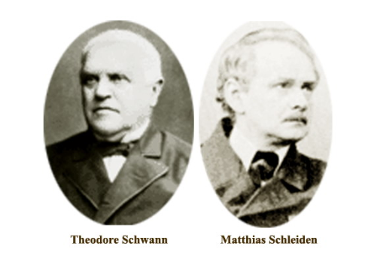
Theodore Schwann - zoologist who observed tissues of animals had cells (1839)
Mattias Schleiden - botanist, observed tissues of plants contained cells ( 1845)
Rudolf Virchow - also reported that every living thing is made of up vital units, known as cells. He predicted that cells come from other cells. (1850 )

Slide 6
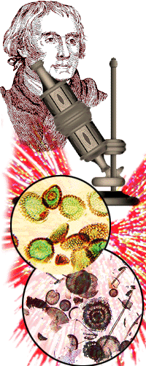
The Cell Theory
1. Every living organism is made of one or more cells.
2. The cell is the basic unit of structure and function. It is the smallest unit that can perform life functions.
3. All cells arise from pre-existing cells.
*Why is the Cell Theory called a Theory and not a Fact?

Slide 7
Comprehension Checkpoint
True or false….
Robert Hooke was the first person to see cells.
The Cell Theory was developed by a single scientist.
Cells can only come from pre-existing cells.
It only took five years to develop the Cell Theory.
Who used the first microscope?
Who said that plants were made of cells?
Who coined the term “cell”?
Who said that all animals were made of cells?
Who said that cells must come from existing cells?

Slide 8
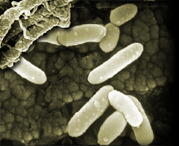
Examples of Cells
Amoeba Proteus
Plant Stem
Bacteria
Red Blood Cell
Nerve Cell

Slide 9
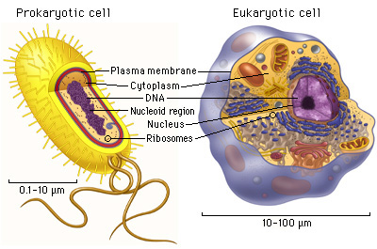
Two Types of Cells
Prokaryotic
Eukaryotic

Slide 10
Prokaryotic
Do NOT have a membrane bound nucleus
Few internal structures
One-celled organisms, Bacteria

Slide 11
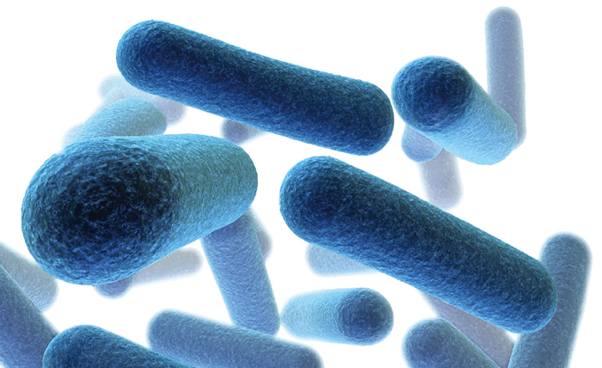
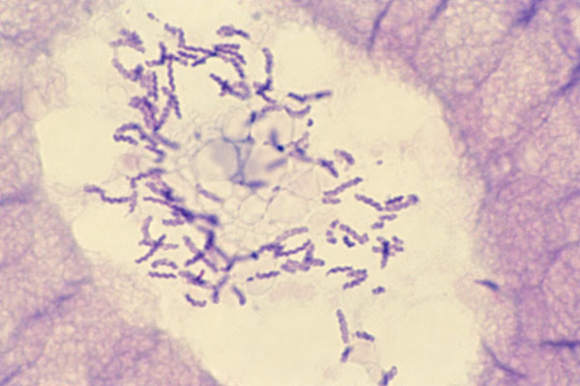
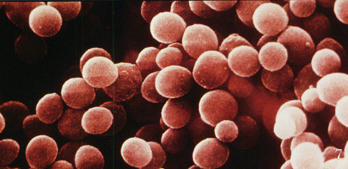
Prokaryotic Cells
Rod shaped
Spherical
Spiral

Slide 12
Eukaryotic
Contain organelles, including a nucleus surrounded by membranes
Most living organisms
Plant
Animal

Slide 15
Plant Cell | Animal Cell
Cell structure is rectangle | Cell structure is round
One LARGE vacuole | Several small vacuoles
Chloroplast- Green food making orgnelles | No chloroplasts
Cell Wall- Helps to support the plant | No Cell Wall

Slide 16
Comprehension Check
What are the two types of cell?
What type of cell are bacteria?
What type of cell has a nucleus?
Which type of cell lacks a nucleus?

Slide 17
Types of Molecules
Nucleic Acids
Amino Acids
Sugars
Lipids

Slide 18
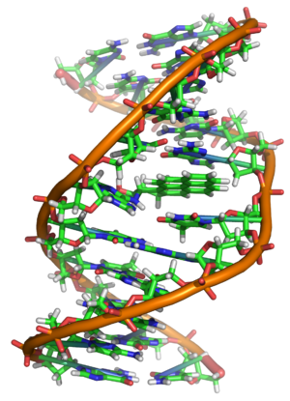
Nucleic Acids
The “building blocks of loving organisms”
DNA – Deoxyribonucleic Acid
Holds the code for every cell in the organism
Genetic information is stored here
RNA – Ribonucleic Acid
Serves as a genetic messenger and relays information from the DNA to the cells where it will be used to create proteins

Slide 19
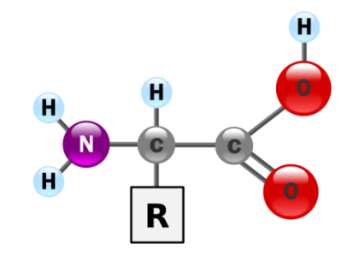
Amino Acids
The “building blocks” of proteins
20 different kinds of amino acids
Plants make all of their own
Animals only make 10 and must consume the others

Slide 20
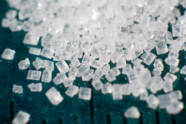
Sugars
Sugars provide the energy resource for cells
Also used as a form of energy storage in cells

Slide 21
Lipids
Lipids are made of fatty acid molecules
They are a valuable energy source and provide twice the amount of energy as sugars

Slide 22
Comprehension Check
What is the relationship between RNA and DNA?
What is an amino acid?
What do sugars provide the cell with?
What are lipids made of?

